Slide 1
Module 17 Challenge
Deliverable 4

Slide 2
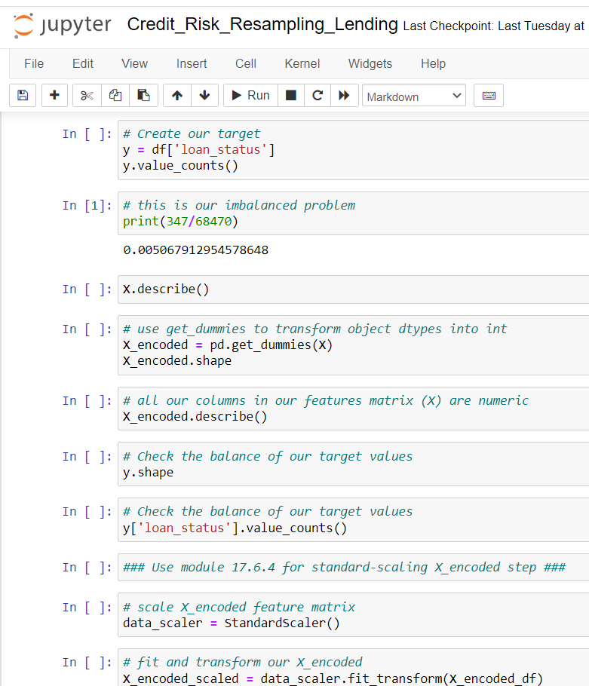
Output 1

Slide 3
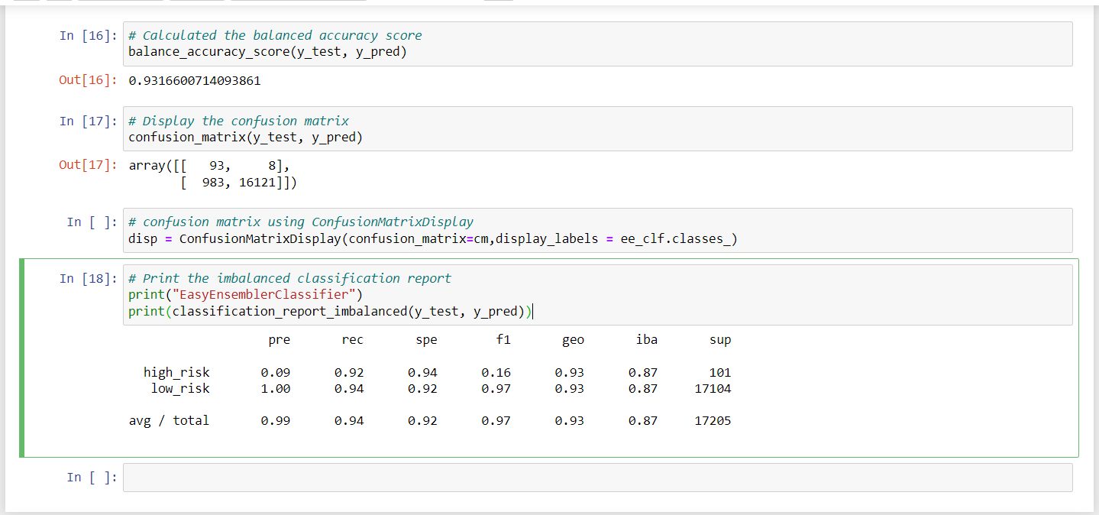
Output 2

